Slide 1
Microsoft Teams API in Microsoft Graph
NarasimaPerumal Chandramohan
Co-Founder, JiJi Technologies Private Limited
Microsoft Office 365 MVP
@narasimaperumal

Slide 2
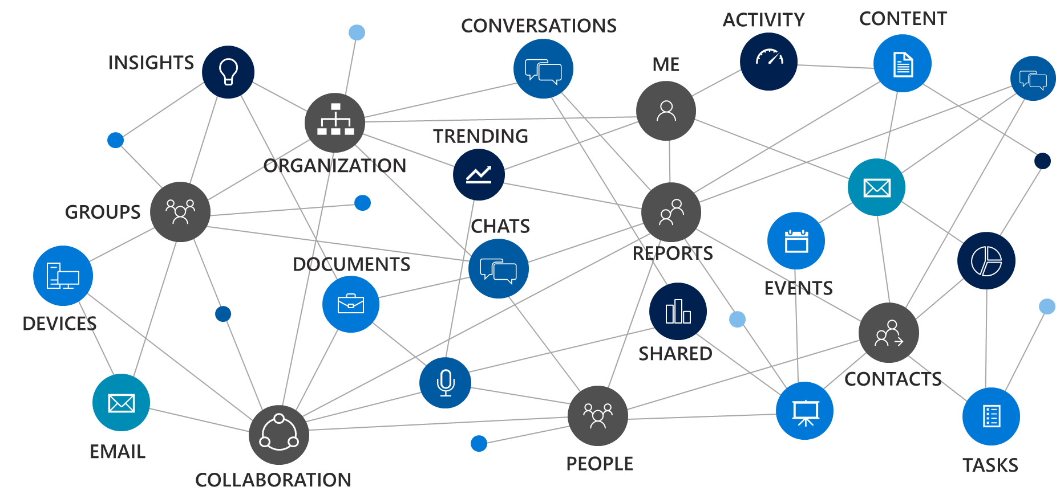
Microsoft Graph
a unified REST API
and comprehensive developer experience
for integrating the data and intelligence
exposed by Microsoft services.
Notes:
Most of you came to this conference because you have real customers that have data in Microsoft Services. Microsoft Graph is the way to access that data.

Slide 3






A powerful platform for higher performing teams
Tabs
Bots
Surface rich content within Teams
Help users get tasks done in conversations
Connectors
Activity Feed
Post rich updates to channels
Engage users via feed notifications
Actionable Messaging
Messaging Extensions
Add rich interaction to your connector cards
Allow users to query and share rich cards in conversations
Microsoft Graph
Build in intelligence and connect to data that drives productivity

Slide 4


A powerful platform for higher performing teams
Tabs
Bots
Surface rich content within Teams
Help users get tasks done in conversations
Connectors
Activity Feed
Post rich updates to channels
Engage users via feed notifications
Actionable Messaging
Messaging Extensions
Add rich interaction to your connector cards
Allow users to query and share rich cards in conversations
Web sites
Services

Slide 5
Graph can automate team lifecycles
Create a team
Add members and owners
Configure team settings
Add channels
Archive or delete the team when the time comes
Install apps
Add tabs

Slide 6
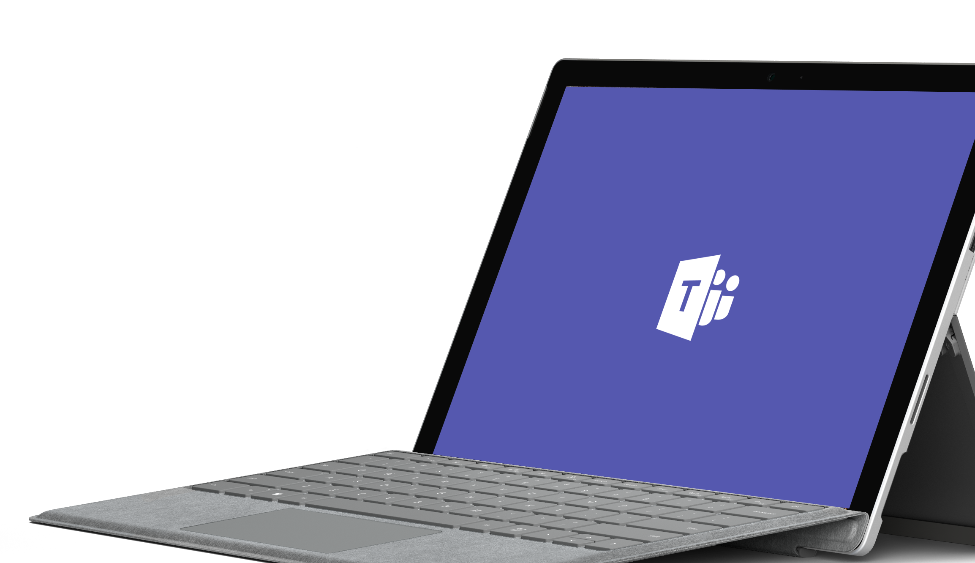
Demo
Notes:
Demos are most effective with customers enabling us to bring the product to life. Please leverage the demo script on Office OnRamp: https://view.officeapps.live.com/op/view.aspx?src=https://demos.microsoft.com/api/download/00000000-0000-0000-0000-000000000000/636551932331784273/Microsoft%20Teams%20Demo%20Guide.docx
As alternative to a live demo, please leverage the PowerPoint Click Through Demo or the following six slides.
If you demo Teams, you can use the slides to recap the main points of the demo.

Slide 7
App registration
Graph calls need a Graph appId.
Graph appId != Teams appId
Register a Graph app:
https://apps.dev.microsoft.com
Create a Converged Application
Or use your botId if you have a bot.

Slide 8
Permissions
Two types of permissions:
User delegated permissions for when there is a user present
Application permissions for when there isn't
Teams APIs require Group.Read.All or Group.ReadWrite.All
For user delegated, means all groups the user can read/write
For application permissions, means all groups in the tenant
Admin consent required for both user delegated and application permissions

Slide 9

Resource-Specific Consent (RSC)
Microsoft Graph APIs
Microsoft Teams Apps

Slide 10
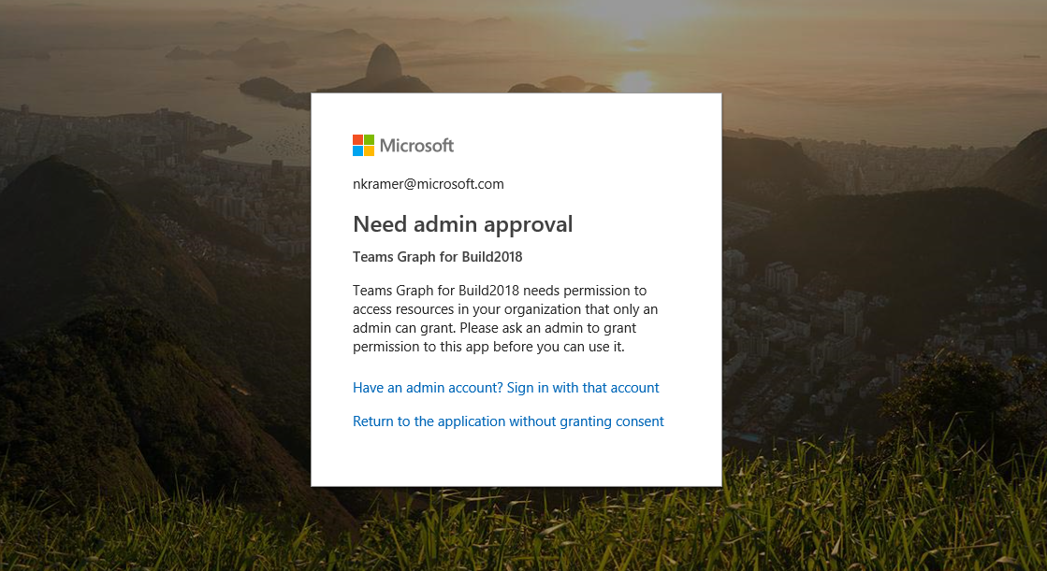
Today, using Microsoft Graph APIs for Teams Apps

Slide 11
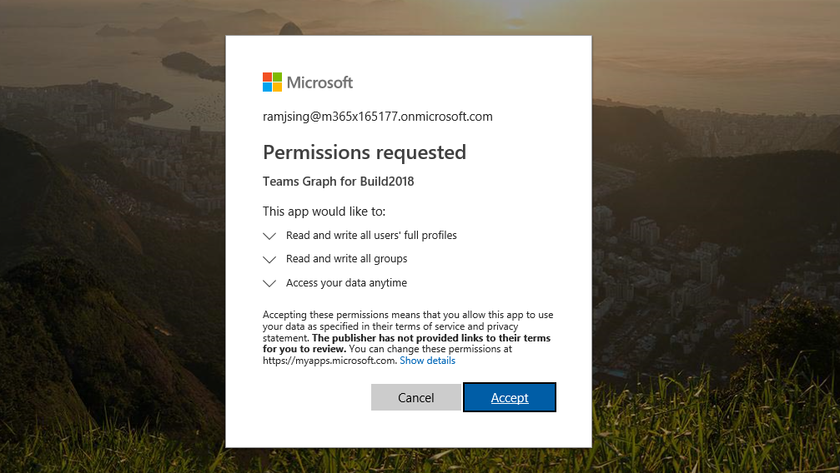
Why would a tenant admin approve this?

Slide 12
What does that app have access to?
 | Team1 | Team2 | Team3 | Team4
Messages | ReadWrite | ReadWrite | ReadWrite | ReadWrite
Channel structure | ReadWrite | ReadWrite | ReadWrite | ReadWrite
Membership | ReadWrite | ReadWrite | ReadWrite | ReadWrite
Files | ReadWrite | ReadWrite | ReadWrite | ReadWrite
Calls | ReadWrite | ReadWrite | ReadWrite | ReadWrite
Notebook | ReadWrite | ReadWrite | ReadWrite | ReadWrite
Calendar | ReadWrite | ReadWrite | ReadWrite | ReadWrite
Plans | ReadWrite | ReadWrite | ReadWrite | ReadWrite
Team settings | ReadWrite | ReadWrite | ReadWrite | ReadWrite
Everything!
(Group.ReadWrite.All)
Everything!
(Group.ReadWrite.All)

Slide 13
What do we really want?
 | Team1 | Team2 | Team3 | Team4
Messages | Read, Send | None | None | Read, Send
Channel structure | Read | None | None | Read
Membership | Read | None | None | Read
Files | Read, Add | None | None | Read, Add
Calls | None | None | None | None
Notebook | None | None | None | None
Calendar | None | None | None | None
Plans | None | None | None | None
Team settings | None | None | None | None

Slide 14
Solution: Resource-Specific Consent
Team owners can consent to the use of team data
Admins can decide to allow this capability in the first place, and team owners can consent
Teams app manifest specifies:
The associated Azure AD App ID
Required (RSC) permissions

Slide 15
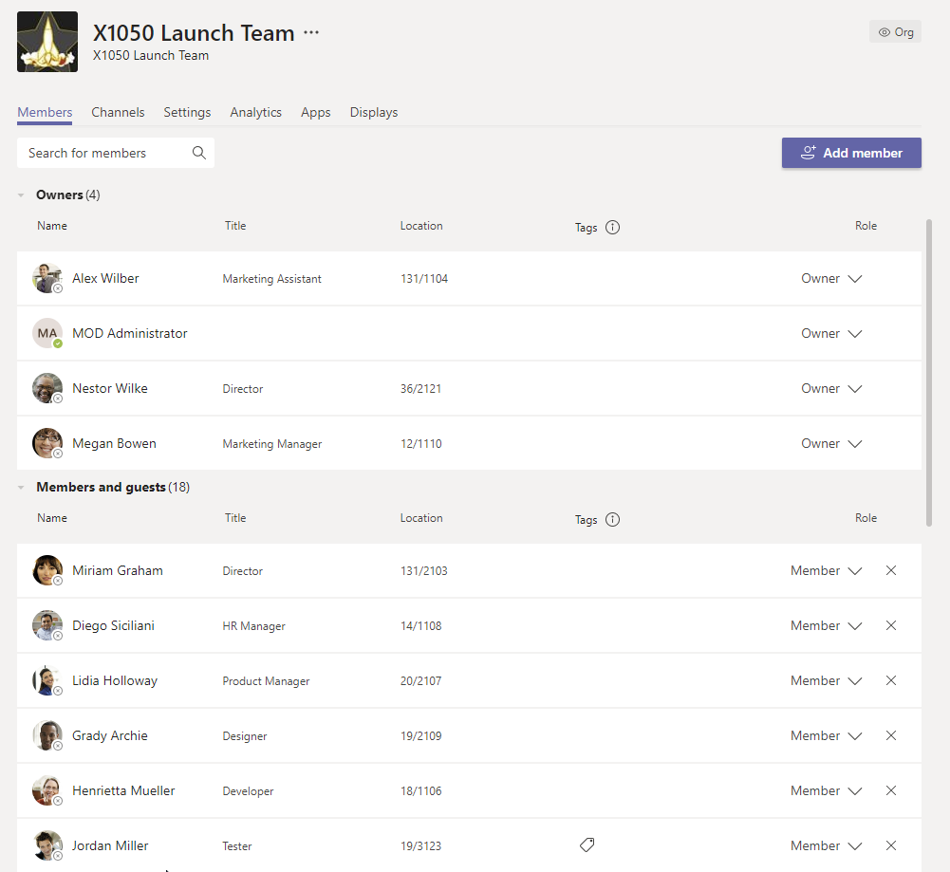
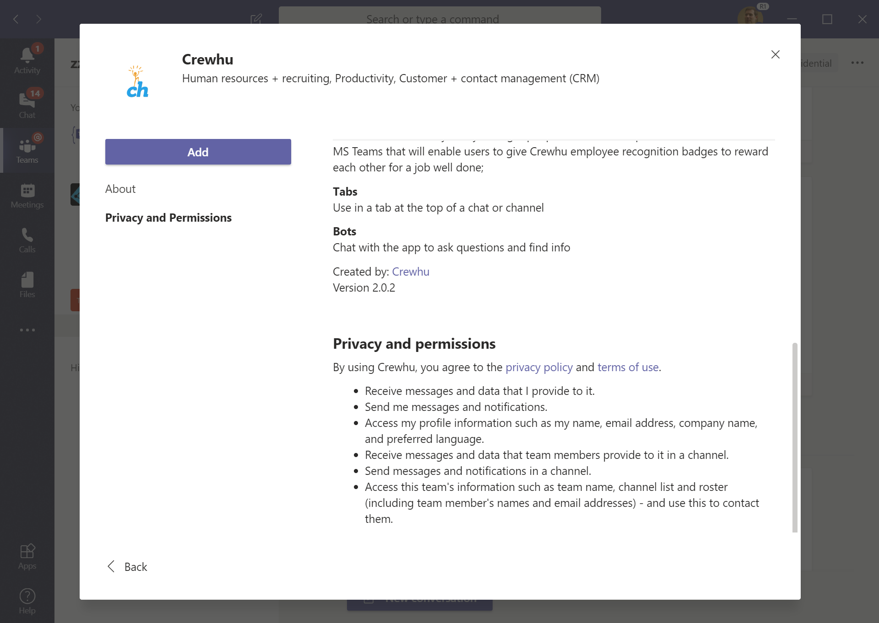
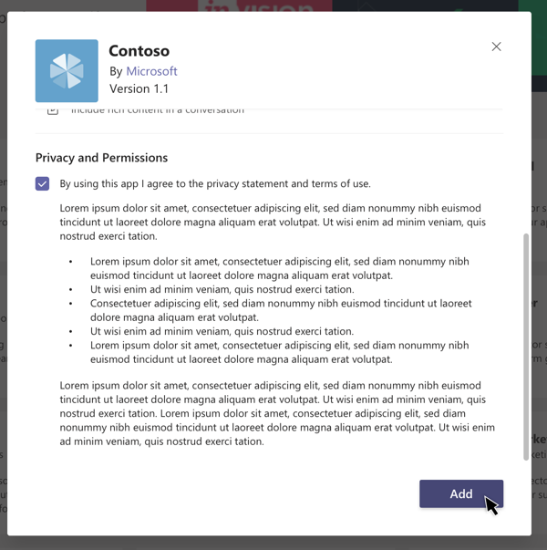
New Consent Experience for Team Owners
Team owner installs an app into their team.
Privacy and Permissions section of the dialog lists the app's requested permissions.
Adding the app grants the permissions it requested.
New RSC permissions
Create and delete channels in this team.
Maintain access to data you have given it access to.

Slide 16
New permissions
Text in UI | Permission scope
Read this team's settings. | TeamSettings.Read.Group
Read this team's channel names, channel descriptions, and channel settings. | ChannelSettings.Read.Group
Edit this team's channel names, channel descriptions, and channel settings. | ChannelSettings.Edit.Group
Create channels in this team. | Channel.Create.Group
Delete this team's channels. | Channel.Delete.Group
Read this team's channel messages. | ChannelMessage.Read.Group
See which apps are installed in this team. | TeamsApp.Read.Group
Read this team's tabs. | TeamsTab.Read.Group
Create tabs in this team. | TeamsTab.Create.Group
Edit this team's tabs. | TeamsTab.Edit.Group
Delete this team's tabs. | TeamsTab.Delete.Group
Read this team's members. | Member.Read.Group
Read this team's owners. | Owner.Read.Group
Add and remove members from this team. (fast follow) | Member.ReadWrite.Group
Add and remove owners from this team. (fast follow) | Owner.ReadWrite.Group

Slide 17
Step 1: Declare RSC permissions in manifest
{
"$schema": ".../MicrosoftTeams.schema.json",
...
"webApplicationInfo": {
"id": "db5c3ee6-4180-4b81-b080-a3ce61e16b66",
"applicationPermissions": [
"Channel.Delete.Group",
"ChannelMessage.Read.Group",
"TeamsApp.Read.Group"
]
},
...
}

Slide 18
Step 2: Get an access token
HTTP POST https://login.microsoftonline.com/{tenantId}/oauth2/v2.0/token
Content-Type: application/x-www-form-urlencoded
Body:
grant_type=client_credentials& client_id={appId}&client_secret={appSecret}&
scope=https%3A%2F%2Fgraph.microsoft.com%2F.default
Step 3: Call an API with the token

Slide 19
V1 Caveats
No Files
Application permissions
Can’t create teams
Just regular channels – not private channels, not chats
Team owners only
No apps installing apps
Watch your App IDs and where you use them
RSC in locked-down tenants (user consent is disabled)
Developers must deal with multiple tokens

Slide 20
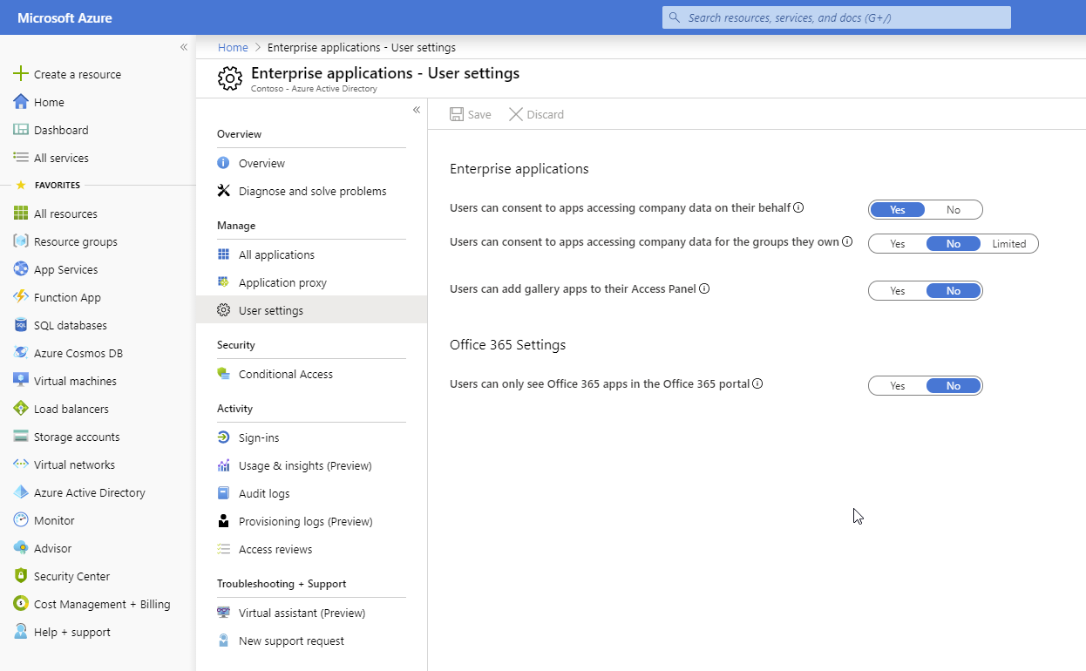
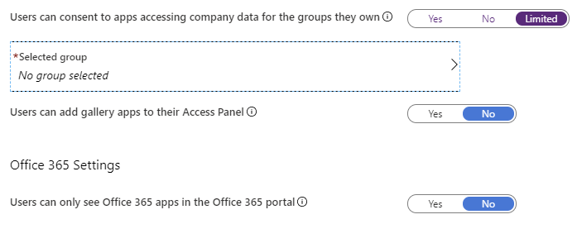
New Tenant Admin Settings
If this option is set to yes, then all users who are owners of a group may consent to allow third-party multi-tenant applications to access the data of the groups they own. If this option is set to no, then no user can consent to those application to access the data of the groups they own. If this option is set to limited, then only the members of the group selected can consent to those applications to access the data of the groups they own.
Set-MsolCompanySettings PowerShell cmdlet
UsersPermissionToUserConsentToAppEnabled
EnableGroupSpecificConsent
ConstrainGroupSpecificConsentToMembersOfGroupId
Default state is based on the current state of end user consent flag (enabled for new tenants)
https://portal.azure.com/?feature.groupspecificconsent=true#blade/Microsoft_AAD_IAM/StartboardApplicationsMenuBlade/UserSettings/menuId/

Slide 21
RSC Timeline
Enabled for all tenants worldwide – complete
Onboard early adopters – late October (complete)
Office 365 Message Center announce – 11/7
Ignite Demo (now!)
Beta enabled for public Teams client (early January 2020)
GA – (Hopefully) Late Q1, early Q2, depending on feedback

Slide 22
Microsoft Graph APIs for Team and User Lifecycle
1.0 APIs
Resource | Actions | App permissions?
Team | List, create, read, update, delete Clone, Archive/unarchive | Supported
Members & Owners | List, add, remove | Supported
Team Settings | Read, write | Supported
Channels | List, create, read, update, delete | Supported
Tabs | List, create, read, update, delete | Supported
Apps installed in teams | List, install, upgrade, remove | Supported
App catalog | List, publish, upgrade, remove | No, user-delegated only
Beta APIs
Resource | Actions | App permissions?
Private Channels | Add user, remove user, update role | Supported
Per-user apps | List, install, upgrade, remove | Supported

Slide 23
API Detail
Resource | Actions | User delegated? | App permissions?
Channel message | Read messages and replies Send Filter by date Notification/webhook (tenant-wide) Notification/webhook (one channel) | Done Done Done Planned Planned | Done Done: install a bot Done Planned Planned
Images in messages | Read | Done | Done
1-1 / Group chat message | Read Send Filter by date Notification/webhook (tenant-wide) | Done Not soon Planned Planned | Planned Done: install a bot Planned Planned
1-1 / Group chat membership | Read members | Done | Done

Slide 24
Future Investments
Sending chat messages with embedded images
Notification/webhook for all chats for a single user
Add/remove members to 1:1 and group chats
Other APIs
Presence
Calling and Meeting GA
Meeting recording stream and transcription
Feedback on these or other APIs? https://microsoftteams.uservoice.com

Slide 25
Get started today: https://graph.microsoft.com
Docs: https://aka.ms/teamsgraph/v1
Samples: https://github.com/microsoftgraph/contoso-airlines-teams-sample
Feedback:
UserVoice
Stack Overflow ([microsoft-graph] [microsoft-teams])
mailto:TeamsGraph@microsoft.com

Slide 26
Next steps
Resources
Get started Start using Microsoft Teams today
Get technical with Microsoft Teams Development Education series
Play with hands-on-labs
Join the Teamwork Solution Accelerator for Partners
Access resources & support Get Teams deployment & adoption support from
FastTrack
https://aka.ms/SuccessWithTeams
Teamwork Solution Accelerator: https://aka.ms/TeamworkSolutionAccelerator
Teamwork Assessment Workshop: aka.ms/TeamworkAssessment
Teams Dev center: https://aka.ms/TeamsDeveloper
Developer support: https://aka.ms/TeamsDevSupport
Teams Dev docs: https://aka.ms/TeamsDevDocs

Slide 27

Enjoy the Bootcamp

Slide 28

Call to action
(Recommendation to Bootcamp organizers and speakers: This slide can be used at the end of the Bootcamp to have attendees to fill online feedback form and recommendation for their ongoing learning and app development on Office 365 platform. Please keep the first three bullet points, you can update the last bullet point to be the user group or community that you are leading that you’d like attendees to join and learn more. Please keep the first feedback bullet point at the top and feel free to re-arrange the rest of bullet point orders. Thanks.
Share your feedback on Bootcamp at https://aka.ms/Microsoft365DevBootcampSurvey2019
Join Office 365 developer program https://dev.office.com/devprogram to leverage all resources for Office 365 development learning
Build applications on Office 365 platform
Attend MVP led local community events to continue learning on Office 365 development

